Slide 1
Particles, Point Cloud, and Sprites
05111840000056 - Herri Purba
05111840000066 - Kevin Christian Hadinata
05111840000069 - Muhammad Ilham Bayhaqi

Slide 2
Working with Particles

Slide 3
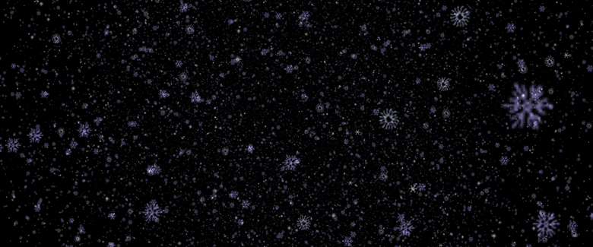

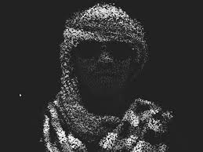
Definition
With particles it is very easy to create many small objects that you can use to simulate rain and snow and can also use particles as a way to create interesting 3D effects.
(source: Learning Three.js- The JavaScript 3D Library for WebGL.pdf)

Slide 4
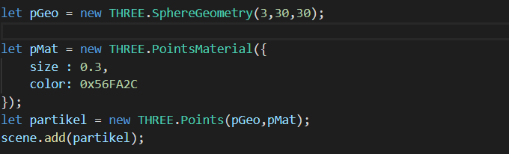
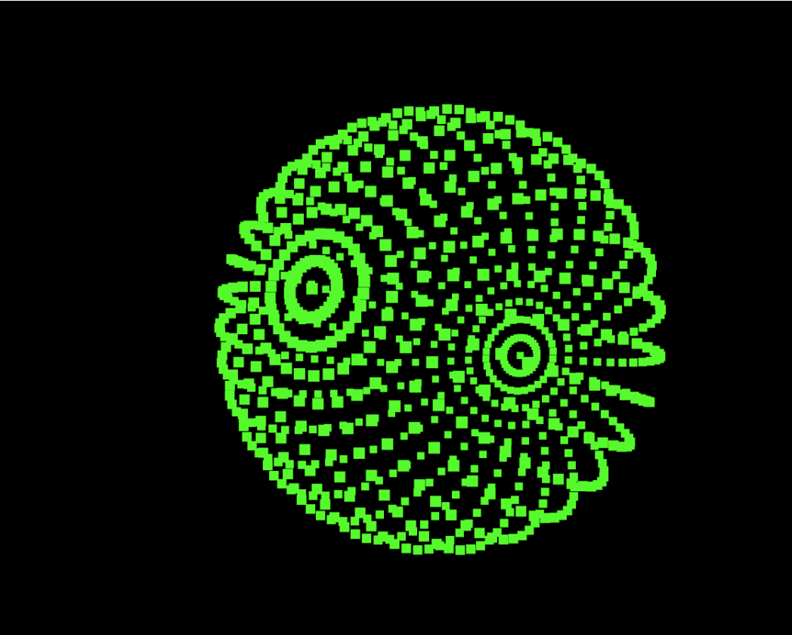
How to make Particles in THREE.js
As we know in three.js there is no documentation about particles so particles can be created using point
This is a particle implementation for creating a sphere

Slide 5
Working with Sprites

Slide 6
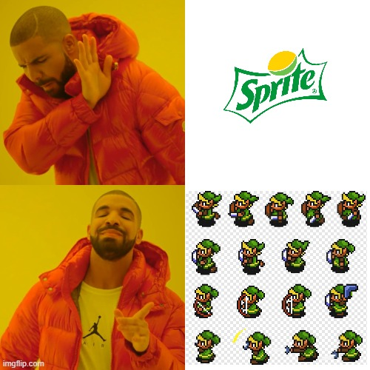
Definition
A sprite is a plane that always faces towards the camera, generally with a partially transparent texture applied.
(source: threejs.org docs)

Slide 7
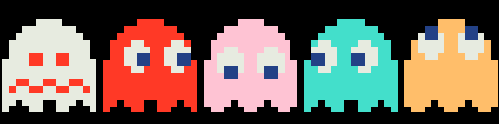
Load it once, shift it around.

Slide 8
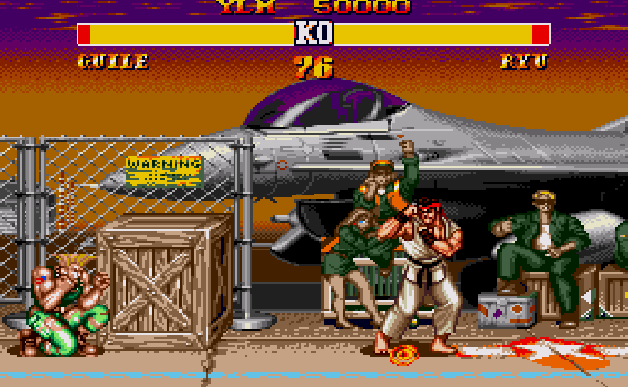
Sprites
Commonly used for video games since the arcade era for animation.

Slide 9
But, Why Sprites?
A usage of sprite (or sprite sheets) can be impactful for, either GPU or HTTP, load performance.
Wouldn’t larger images take longer to load?

Slide 10
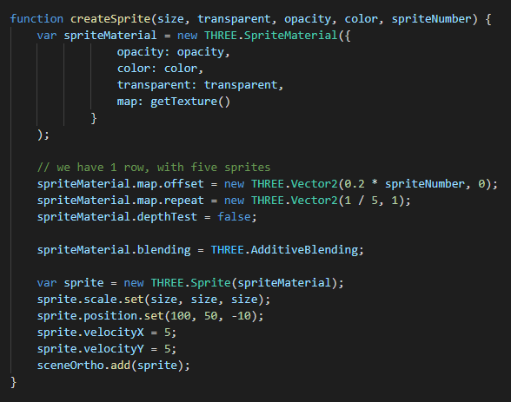
How to use Sprites in THREE.js
Here’s an implementation of sprites working in 2D space:

Slide 11
Properties.

Slide 12
Selecting Which Part of Sprite Appears on Screen.

Slide 13
Working with Point Cloud

Slide 14
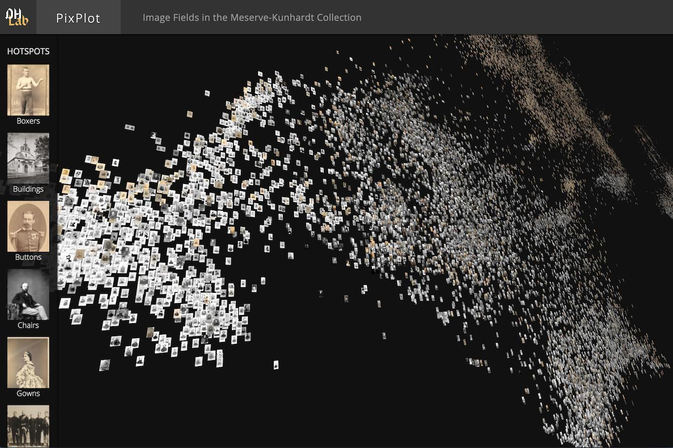
Why we use Point Cloud instead Sprite?
When we working with a large number of particle, we may use Point Cloud because when we using a sprite, it will cause a performance problem.

Slide 15
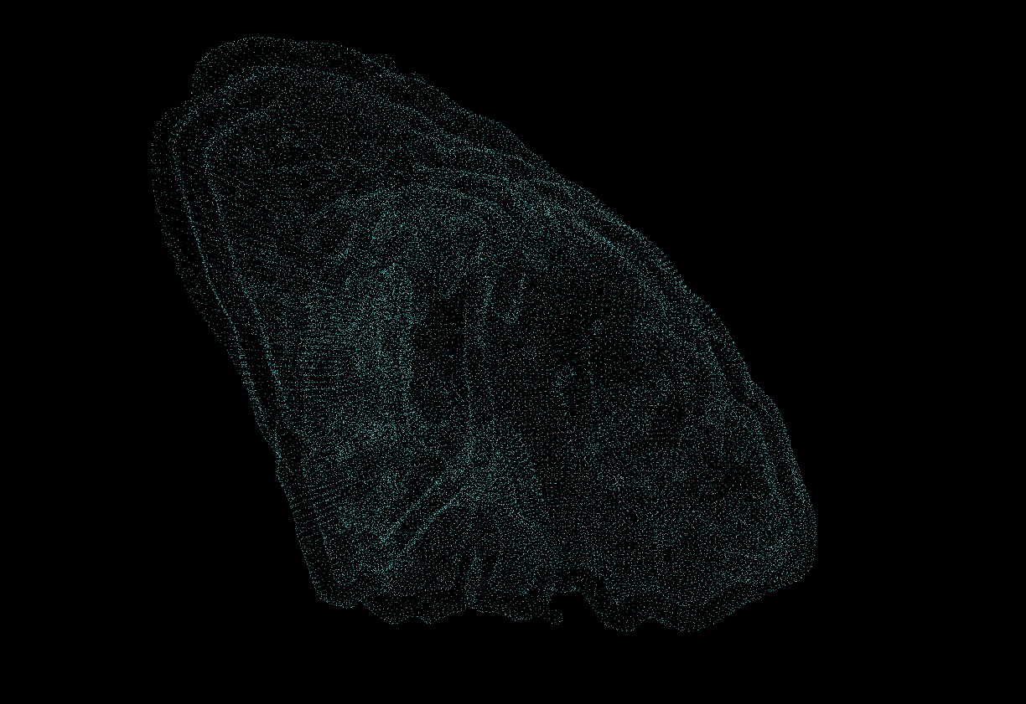
Point Cloud
A class for displaying particles in the form of variable size points.
While every Sprite is an Object 3D, the points of a Point Cloud collectively belong to a single geometry

Slide 16
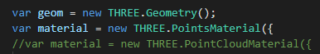
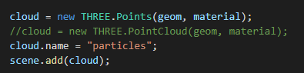
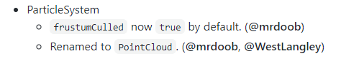
What Component are used in Point Cloud
The constructor of THREE.PointCloud takes two properties:
a geometry
a material
THREE.ParticleSystem -> THREE.PointCloud (R68) -> THREE.Points (R72)

